Slide 1
ML Based House Price Prediction System
Submitted by
Name : Preetam Rawat
Sem : 5
Section : C

Slide 2
Content
Introduction
Problem Statement
Project Specification
Dataset
Model training
Work done till date

Slide 3
Introduction
In this project, I have built a Machine Learning model to predict house price.
This project will be helpful for real estate market
Machine Learning is a type of AI that is defined as the capability of a machine to imitate intelligent human behaviour.

Slide 4
Problem Statement
Prices of real estates properties are sophisticatedly linked with our economy
Despite this, we do not have accurate measures of house price based on the vast amount of data available
Proper and justified prices of properties can bring in a lot of transperancy and trust back to the real estate industry, which is very important for comnsumers.

Slide 5
Project Specification
.
Following utilitites will be used in this project
PYTHON
Python is a high level language.
Python’s built in libraries
make it easy to build machine learning projects
It will be written on jupyter notebook
MACHINE LEARNING
As discussed earlier ML is a is defined as the capability of a machine to imitate intelligent human behaviour

Slide 6
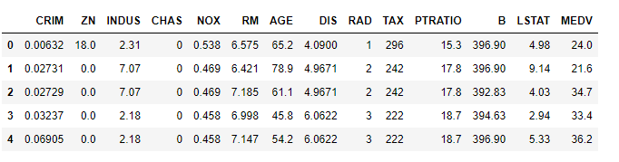
DATASET
I took the dataset from “ uci_ml_repository.com”
My dataset has 13 features and 1 label
There are total 506 number of observations/instances
The 13 features are CRIM, ZN, INDUS, CHAS, NOX, RM, AGE, DIS, RAD, TAX, PTRATIO, B, LSTAT, and the label is MEDV(the price of the house)

Slide 7
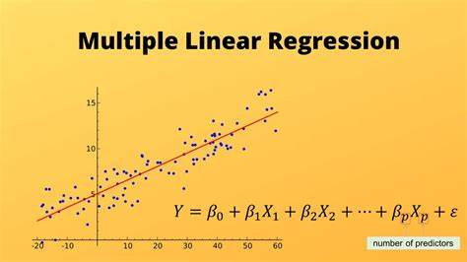
Model Training
In order to make our program functional we need to train it.
Model training is done by creating an algorithm and feeding a lot of data to it.
In my case I am using “Multiple Linear Regression”.
This regression model estimates the relationship between a dependent variable and multiple independent variable(13 in our case).

Slide 8
Work Done Till Date
Sucessfully learned python and basics of Machine Learning.
Gathered the dataset from UCI ML Repository and imported it in my python code after converting it into csv file.
In the coding part I am done with Train-Test Splitting(Dividing the dataset into two parts, one part is used for traing the model and other part is used for testing the model).

Slide 9
Thank You

